Slide 1
Preesented By Subhajit Barh
Roll- 18MA60R33
Dept:-Mathematics
(CSDP)
Linux Kernel Exploit
CVE-2016-5195
Presented By
Subhajit Barh
Roll-18MA60R33
Dept:-Mathematics
IIT KHARAGPUR

Slide 2

(CVE-2016-5195)
Linux Kernel Exploit

Slide 3
Possible Questions
What is Dirty Cow?
What is with the weird Name?
What is a Kernel??
What is Privilege Escalation?
What is its impact??
And So on .......

Slide 4
What is Dirty COW
Dirty COW is a Critical(Priv-Esc Type) Security Vulnerability which was present in Linux Kernel.
It was there since kernel version 2.6.22 (released in September 2007)
It was exploited in October 2016
The vulnerability has been patched in Linux kernel versions 4.8.3, 4.7.9, 4.4.26 and newer.
The patch produced in 2016 did not fully address the issue and a revised patch was released on November 27, 2017, before public dissemination of the vulnerability.

Slide 5
Which Means ...
Operating Systems Like
Ubuntu 14.04,12.04,16.10 and Lower
RHEL 7, CentOS 7 and lower
And other Linux Distros which used or still uses those kernels are vulnerable.
That list is quite large.

Slide 6
Outline
What is Privilage Escalation
Linux Permission System
Linux Kernel
Paging and Page Fault
Copy on Write
Dirty Bits
etc.....

Slide 7
Prerequisite
Basic Knowledge of Operating System
Basic Knowledge of C programming
Basic Linux(Bash) Commands

Slide 8
What is privilege Escalation
Privilege escalation is the act of exploiting a bug, design flaw or configuration oversight in an operating system or software application to gain elevated access to resources that are normally protected from an application or user. The result is that an application with more privileges than intended by the application developer or system administrator can perform unauthorized actions.
--Wikipidia

Slide 9
Our Aim .....
To Write in Write Protected Files ....
To become ROOT

Slide 10
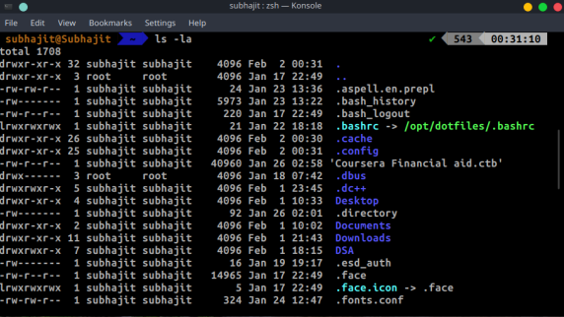
Linux Permission System
-rw-r—r--,
drwxr-xr-x
10 characters
‘-’ if its file and d if it is directory
Next 3 letters are permission for owner
‘r’ means read privilege
‘w’ means write privilege
‘x’ means execution privilege
Next 3 letters are for groups(same description)
Next 3 are for others
Owner
Group
Permission

Slide 11
Continued .......
‘-’ means absent of permission
If ‘-’ is there in place of w that means it is write protected
‘root’ - is the Highest privilege in Linux .
Root has all the permissions that is read write and execute .
We want to become root from normal users ....
Is that possible ?
There is a command called sudo (Superuser Do) which grants you temporary root privilege if you(user) are listened in sudoers(/etc/sudoers) file
What if you are not in sudoers file ?? can you gain root privilege ??
Normally you can’t .......
But you can take advantage of security loop-holes and escalate your privilege
That is called privilege escalation attack.
There are many Priv-Esc methodologies .
One of them is exploiting Kernel .
It is Dangerous and unstable .
But can grant you root privilege
They are Called Kernel Exploits .
Dirty Cow is an Kernel Exploit.

Slide 12
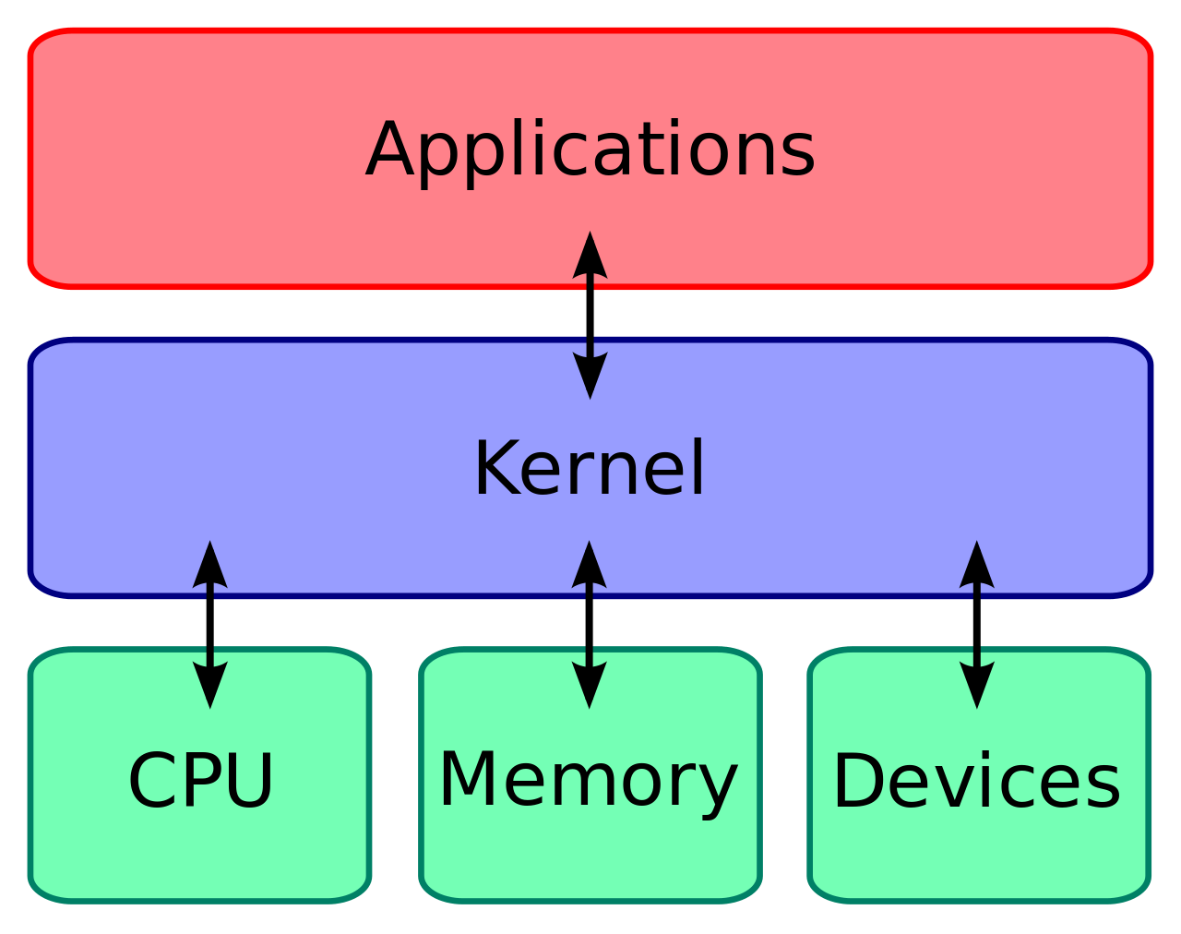
Linux Kernel

Slide 13
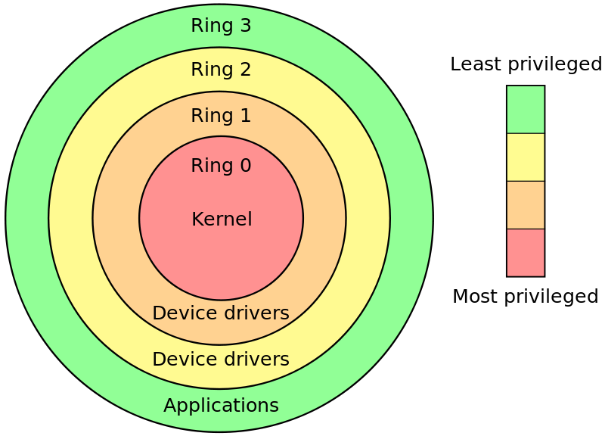
Linux Kernel

Slide 14
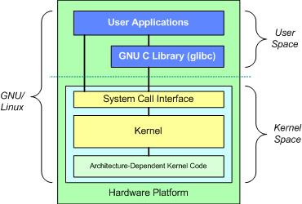
Linux Kernel

Slide 15
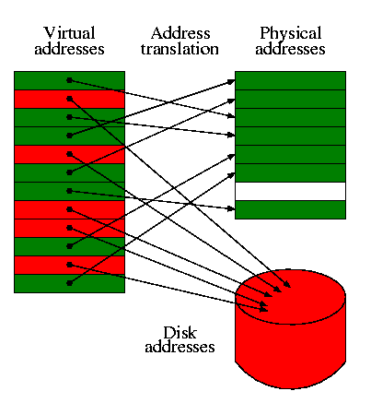
Paging
Paging is a memory management scheme that eliminates the need for contiguous allocation of physical memory. This scheme permits the physical address space of a process to be non – contiguous.

Slide 16
Page Fault
What happens when CPU can not find a physical memory page corresponding to virtual memory?
May be the memory have been swapped to secondary storage ....
MMU can not find the associated page in page table ...
It initiates a page fault trap interrupt .
The page fault handler in the operating system makes an entry for the page in the page table and hands the control to the MMU .
Page Fault can be Hard Fault or Soft Fault .
Soft faults are Common and happens when page is present in the physical memory but just there is no entry in page table for that. CPU finds that memory and and makes entry in page table and hands over control to the main process .
Hard fault is when page has ben swapped in the Hard Disk and CPU need to fetch it from the hard disk to main memory . As Hard Disk is slow it reduces the performance and this phenomenon is called thrashing.

Slide 17
Copy On Write(CoW)
When want to write on any write protect file which is now mapped to the memory Kernel creates a copy of it and writes on it(Copy On Write) .
It is done by using some flags one of them is foll_write(impotent one for this presentation).
If file is not write protected then foll_write is not set and CPU writes the changes to the original mapping of the file.
Now the original user memory page becomes touched or Dirty .
Now if any pages are dirty then it will be written on the disk by the CPU
What happen when CPU initiates a COW page but does not find it .
Definitely a page fault happens and the vulnerability lies in how kernel resolves the fault.
But How we force the page fault in that exact time ?
We will See .......

Slide 18
Dirty Bit
A dirty bit or modified bit is a bit that is associated with a block of computer memory and indicates whether or not the corresponding block of memory has been modified.[1] The dirty bit is set when the processor writes to (modifies) this memory. The bit indicates that its associated block of memory has been modified and has not been saved to storage yet. When a block of memory is to be replaced, its corresponding dirty bit is checked to see if the block needs to be written back to secondary memory before being replaced or if it can simply be removed. Dirty bits are used by the CPU cache and in the page replacement algorithms of an operating system.
-------Wikipidia

Slide 19
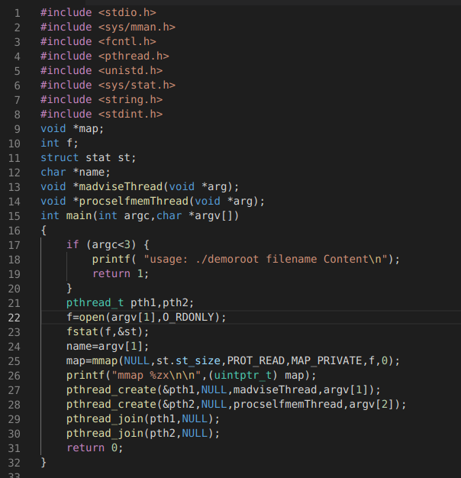

Slide 20
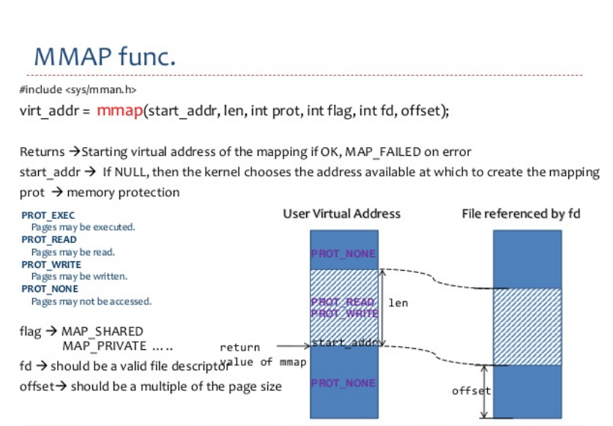

Slide 22
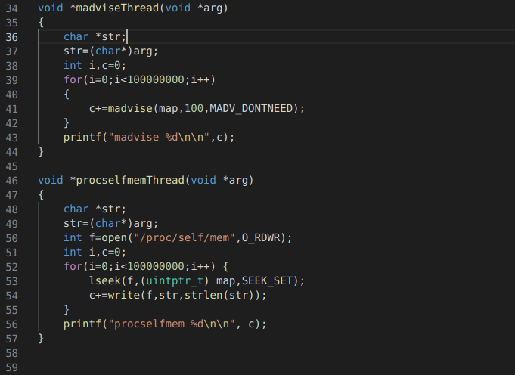

Slide 23
Threading
Write(.......)
Madvise
Write(.......)
Madvise
Madvise
Write(.......)
Madvise
Write(.......)
Madvise
Write(.......)
Madvise
*Privilaged File Over Written

Slide 25
Write Sys Call:
Write(....)
mem_write(....)
mem_rw(...)

Slide 26
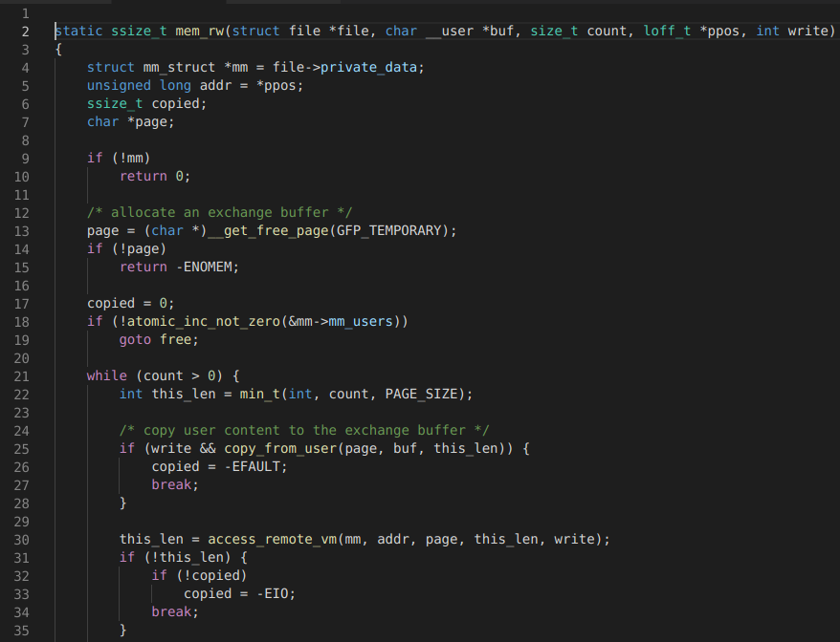

Slide 27
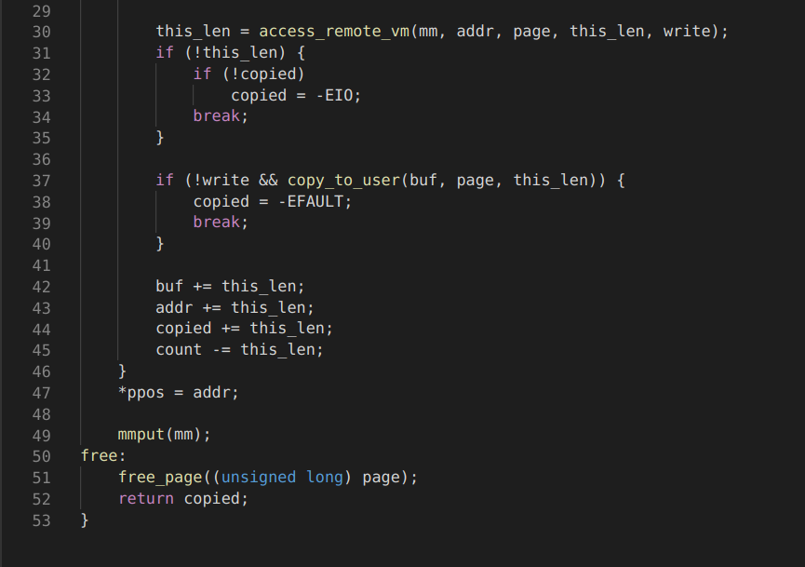

Slide 28
access_remote_vm Calls:
access_remote_vm
flag=FOLL_TOUCH | FOLL_REMOTE | FOLL_GET | FOLL_WRITE | FOLL_FORCE
__get_user_pages_locked(...)
__get_user_pages(flags)

Slide 29
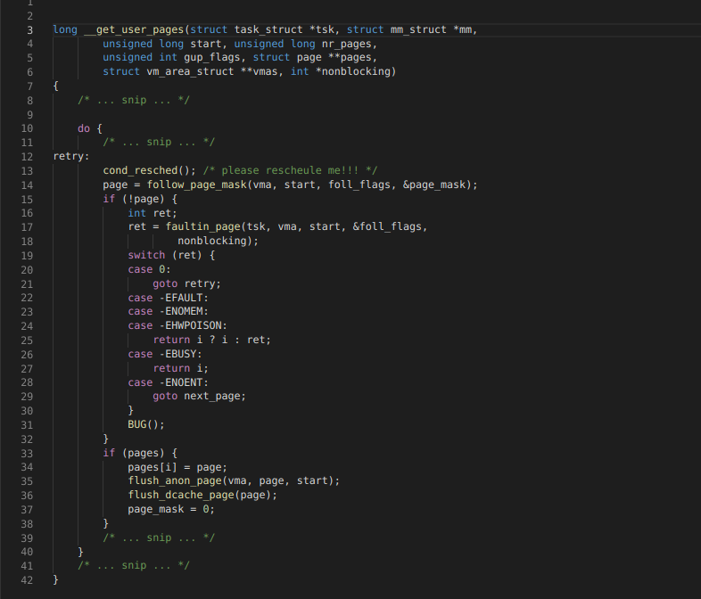

Slide 30
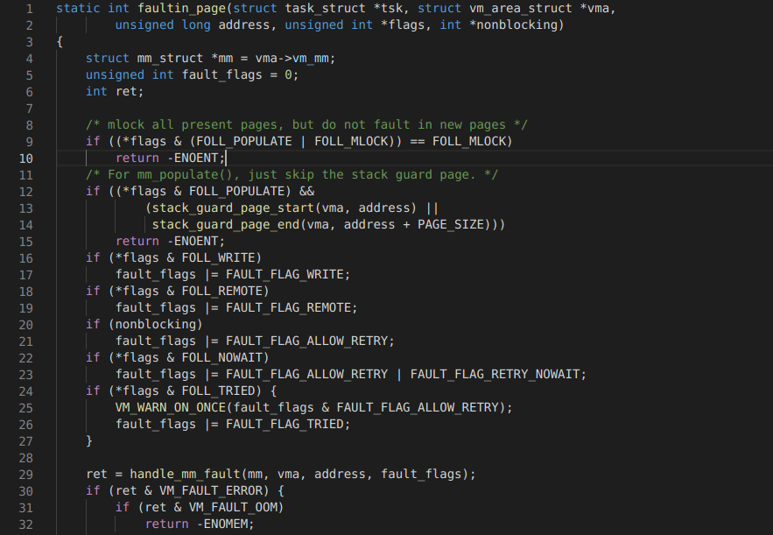
..

Slide 31
handle_mm_fault(....)
faultin_page
handle_mm_fault
__handle_mm_fault
handle_pte_fault
FAULT_FLAG_WRITE && !pte_write
do_wp_page
PageAnon() <- this is CoWed page already
reuse_swap_page <- page is exclusively ours
wp_page_reuse
maybe_mkwrite <- dirty but RO again
ret = VM_FAULT_WRITE

Slide 32
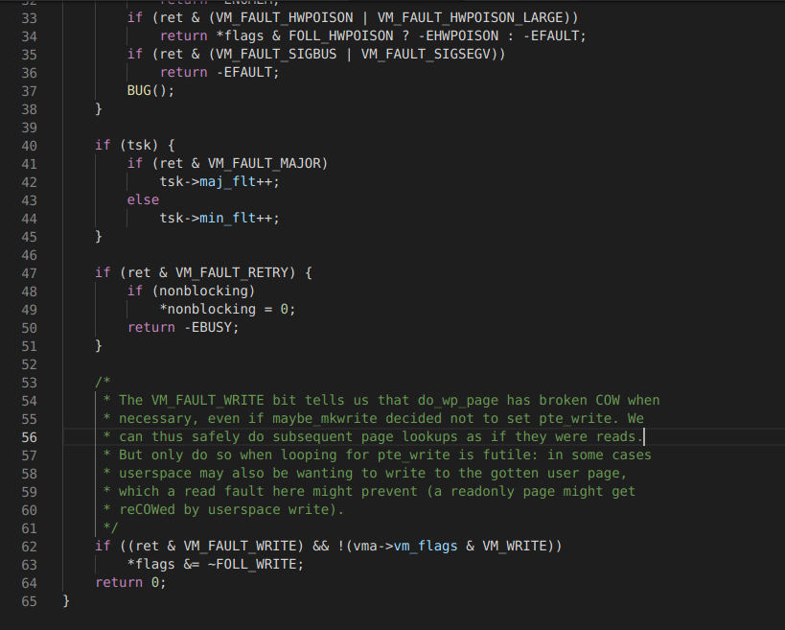
..

Slide 33
access_remote_vm:
/*----------------------snip----------------------*/
maddr = kmap(page);
if (write) {
copy_to_user_page(vma, page, addr,
maddr + offset, buf, bytes);
set_page_dirty_lock(page);
} else {
/* ... snip ... */
}
kunmap(page);
/*----------------------snip----------------------*/

Slide 34
Recap FlowChart
Write
mem_rw
Copy_from_user
acess_remove_vm
__get_user_pages_locked(...)
get_user_pages
faultin_page
ret = handle_mm_fault(mm, vma, address, fault_flags);

Slide 35
Continued....
COW
Remove FOLL_WRITE Flag
Retry on cowed page
CoW page dropped
due to madvise
Retry on original Page
Follow_page_mask_Successful
Follow_pagemask Successful
As FOLL_WRITE is not set
access_remote_vm
access_remote_vm
Make the Original page dirty
Make the CoW page dirty
Original File gets Overwritten

Slide 36
Demo ....

Slide 37
Conclusion
Security is Hard also challenging an fun
Though Linux has open Source code reviewing system it was exploited
This method wont work in Linux 18.04 or more
Because it has been patched
But we should be always care full and be alert about security news.
Regular update and upgrade is required
Magic command “sudo apt update && sudo apt upgrade -y”
Check for malware and through firewall implementation

Slide 38
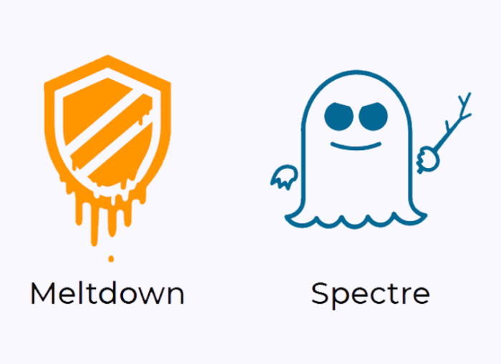
End Note:
CVE-2017-5753 CVE-2017-5715 CVE-2017-5754 CVE-2018-3640
CVE-2018-3639

Slide 39
References ...
https://dirtycow.ninja/https://dirtycow.ninja/
https://github.com/dirtycow/dirtycow.github.io/wiki/PoCs
https://www.us-cert.gov/ncas/alerts/TA18-141A
https://kb.help.rapid7.com/docs/meltdown-and-spectre
https://en.wikipedia.org/wiki/Paging
https://en.wikipedia.org/wiki/Page_fault
https://chao-tic.github.io/blog/2017/05/24/dirty-cow
https://en.wikipedia.org/wiki/Virtual_memory

Slide 40
Questions ???
Thank You

